Slide 1

IoTSafe: A Safe & Verified Security Controller for Internet-of-Things
Tianlong Yu
Notes:
Hello everyone. My name is Tianlong.
It’s my pleasure here to present our IoTNetS Framework, which is a network-based security framework to secure the internet of things.

Slide 2
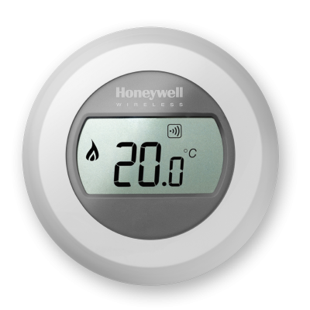

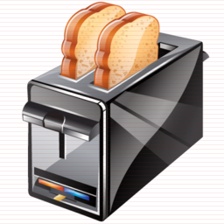
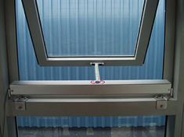
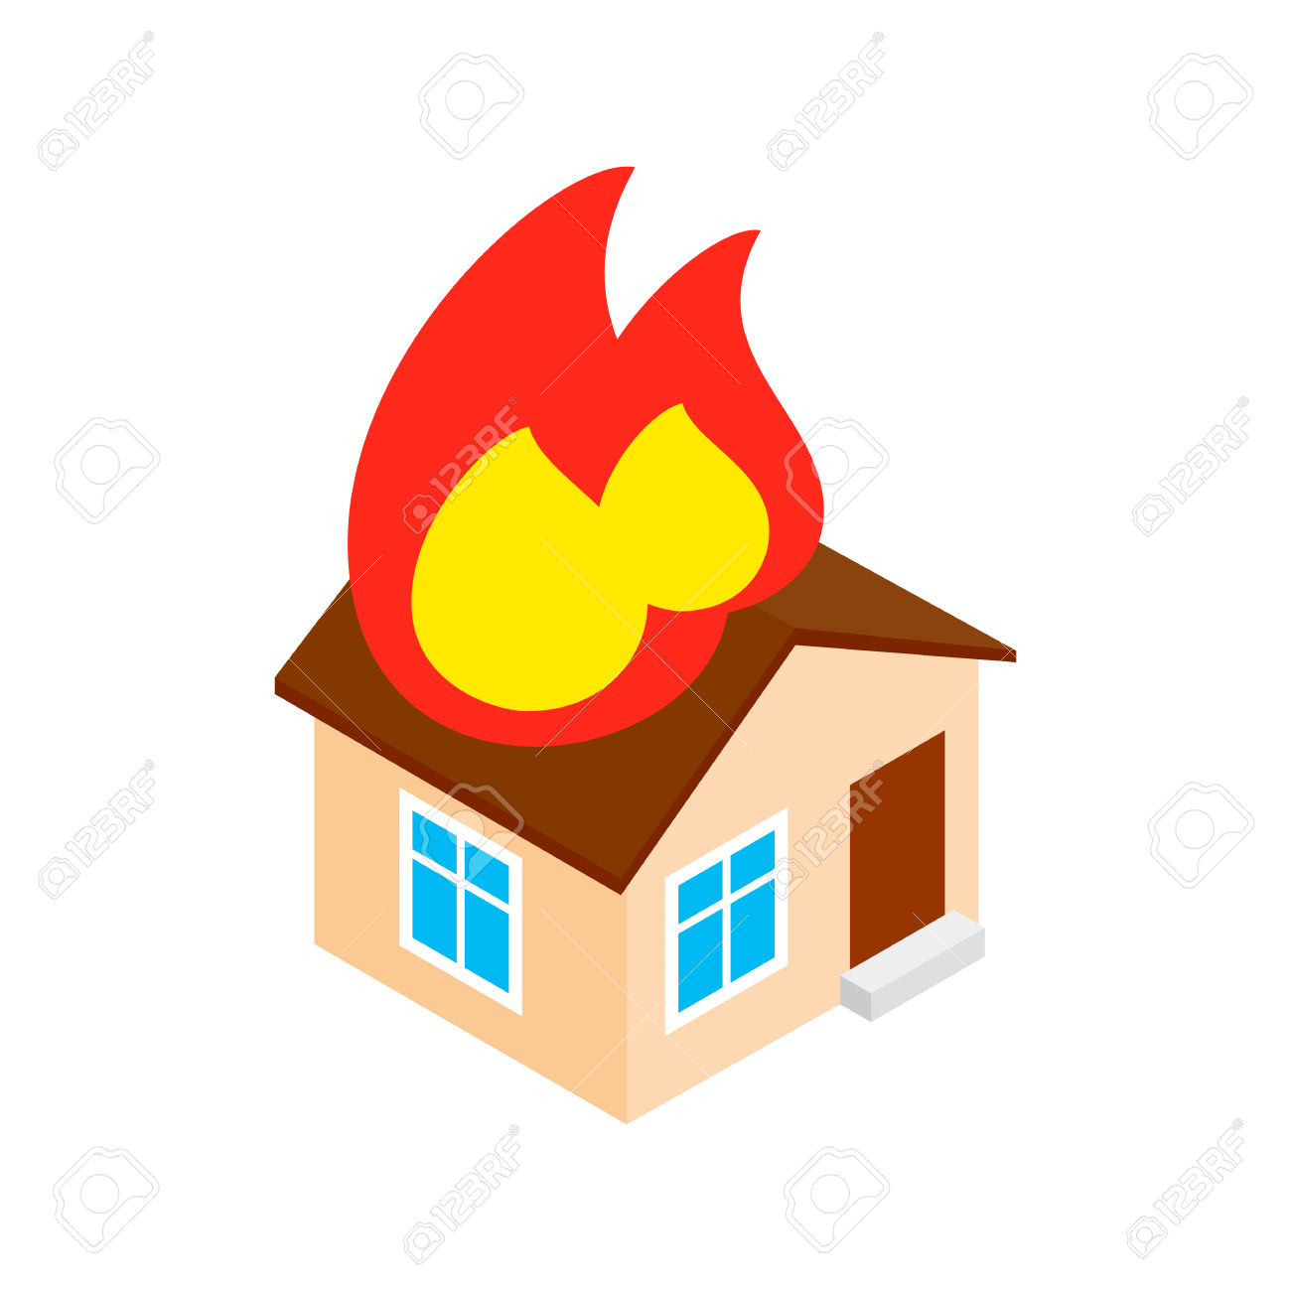



IoT is an impending security disaster
overheat
break-in
crash
fire
IoT devices cause physical damage!!!

Slide 3
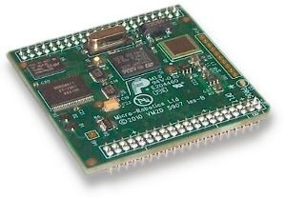


Current approaches fail to secure IoT
✗
✗
Attacker
Embedded
Controller
User
Unfixable Flaws
- Resource
- Management
- Longevity
No physical context
Notes:
To make things worse, current IT approaches fails to secure the IoT devices.
At the end-point, current IT devices are protected by host-based FW/AV/Patches.
Compare with that, we believe the IoT devices have unfixable flaws.
For example, IoT devices have limited resource and cannot support host-based FW/AV.
They are constrained in management and will be used for a long time with no patch or update support.
As a result, the host-based security is not viable for IoT.
Then in the network, current IT approaches use IP-based rules to express the policy to secure the devices.
However, for IoT, the devices have complex interactions with the physical world.
The IP-based rules is not expressive enough to capture the physical context, such as location/temperature, to secure the physical interactions.
Finally, to secure a device we need to learn the benign/malicious behaviors of the device.
In IT, the administrator can manually learn these behaviors based on the common standards and protocols IT devices use.
However, IoT devices lack such common standards/protocols and demonstrates more diverse behaviors.
As a result, there are so many possible behavior of IoT and it’s impossible to manually learn all of them.

Slide 4
IoTSafe Security Controller
Security Controller
Attacker
User
1. Reset device
to safe state
2. Stop potential attacker
Notes:
To make things worse, current IT approaches fails to secure the IoT devices.
At the end-point, current IT devices are protected by host-based FW/AV/Patches.
Compare with that, we believe the IoT devices have unfixable flaws.
For example, IoT devices have limited resource and cannot support host-based FW/AV.
They are constrained in management and will be used for a long time with no patch or update support.
As a result, the host-based security is not viable for IoT.
Then in the network, current IT approaches use IP-based rules to express the policy to secure the devices.
However, for IoT, the devices have complex interactions with the physical world.
The IP-based rules is not expressive enough to capture the physical context, such as location/temperature, to secure the physical interactions.
Finally, to secure a device we need to learn the benign/malicious behaviors of the device.
In IT, the administrator can manually learn these behaviors based on the common standards and protocols IT devices use.
However, IoT devices lack such common standards/protocols and demonstrates more diverse behaviors.
As a result, there are so many possible behavior of IoT and it’s impossible to manually learn all of them.

Slide 5
Project Goals
Room Temperature
Model
✔ Verified Safety
Hybrid
Program
KeYmaera X
IoTSafe
Controller
Implementation
on OpenDayLight
IoT APIs
Security Appliances APIs
Message Verifier
with Snort

Slide 6
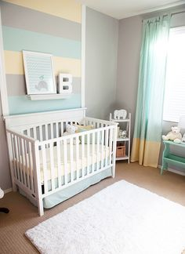

Hybrid Program
Security Controller
Desired
Temperature T_{d}
Attacker
T_{e}
T₁
Message
Verifier
User
Safety 20<=T₁<=24
By Newton’s cooling law:

Slide 7
Hybrid Program Design
/* Controller actions */
If can overheated/overcooled in tc time
Block user/attacker Td change
Reset Td to a safe value
/* User/Attacker Actions */
If user/attacker can change Td
Non-deterministic Td in (Td^{min}, Td^{max})
/* Temperature change in tc time */
Differential equation to describe T change
P1 Event-triggered or
time-triggered?
P2 User/attacker actions?
P3 Controller Actions?
check every tc time

Slide 8
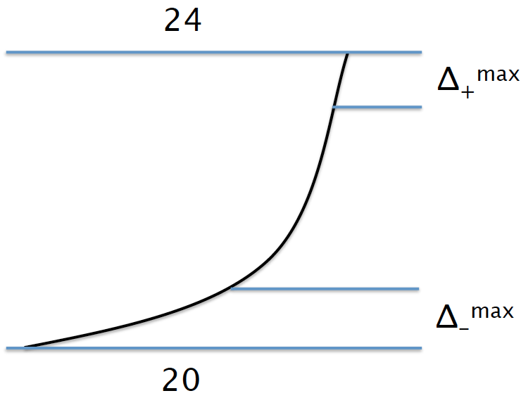
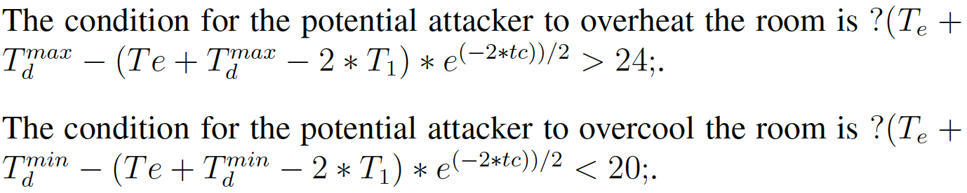

Hybrid Program Design
How to predict overheat/overcool?
How to set Td to safety value?
Stop temperature change
How to describe temperature change?

Slide 9


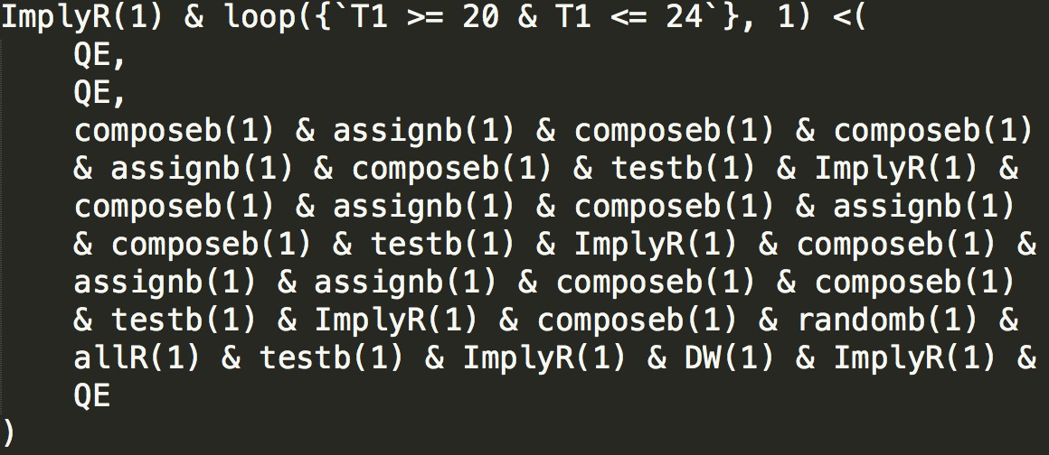
Verification with KeYmaera X

Slide 10




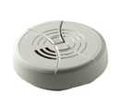
Implementation on SDN controller
overheat/overcool
FW: lock T; Reset Td;
FSM
normal
FW: allow T;
IoTSafe Controller
SDN
IoT APIs
NFV
Security Server
Internet
IoT Gateway
Home Network

Slide 11
Discussion & Future Works
IoT Device Model
Security Policy
Synthesizer
Hybrid
Program
KeYmaera X
Automatic
Translation?
Automatic
Verification?
IoTSafe
Controller

