Slide 1
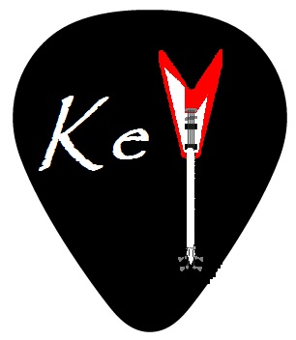
KeYTuner: A Hybrid Guitar Tuning System
Pallavi Santosh
psanthos@andrew.cmu.edu

Slide 2
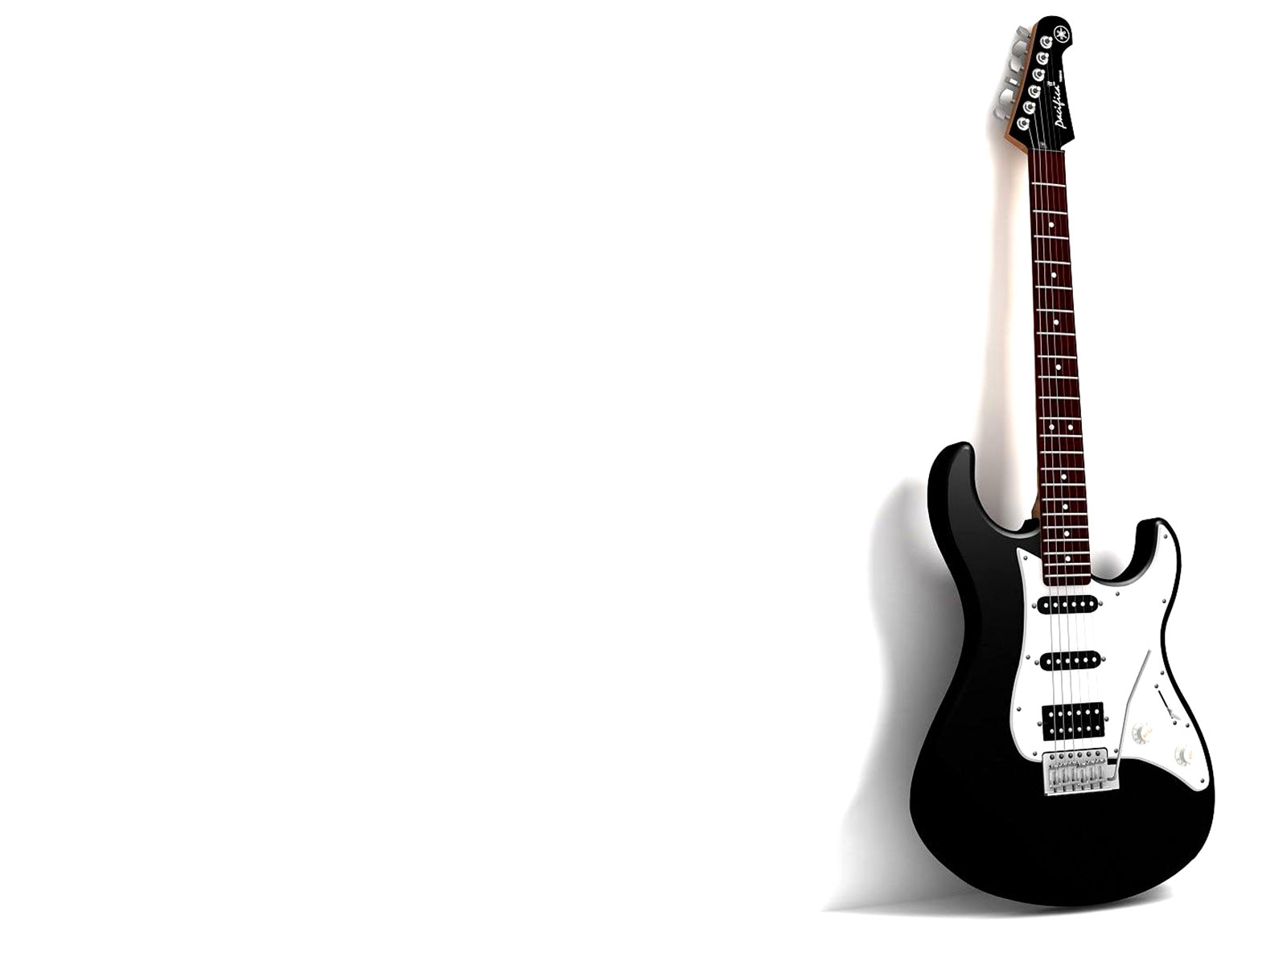
INTRODUCTION
Clip-on tuner used to tune the strings of a guitar
Automates the rotation of the peg,
ensuring that it rotates until the string is tuned

Slide 3
OUTLINE
MOTIVATION
BACKGROUND
THEORY
MODEL
CONCLUSION

Slide 4
MOTIVATION
String instruments require regular tuning
KeYTuner clips on to an instrument and tunes it automatically.

Slide 5
BACKGROUND
Strobe
Vibration
Microphone
All indicate state of tuning of the strings

Slide 6
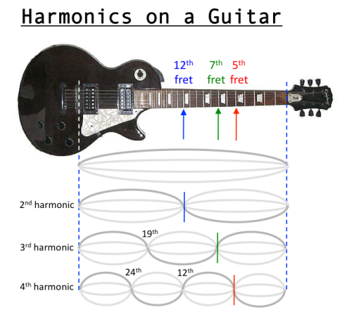
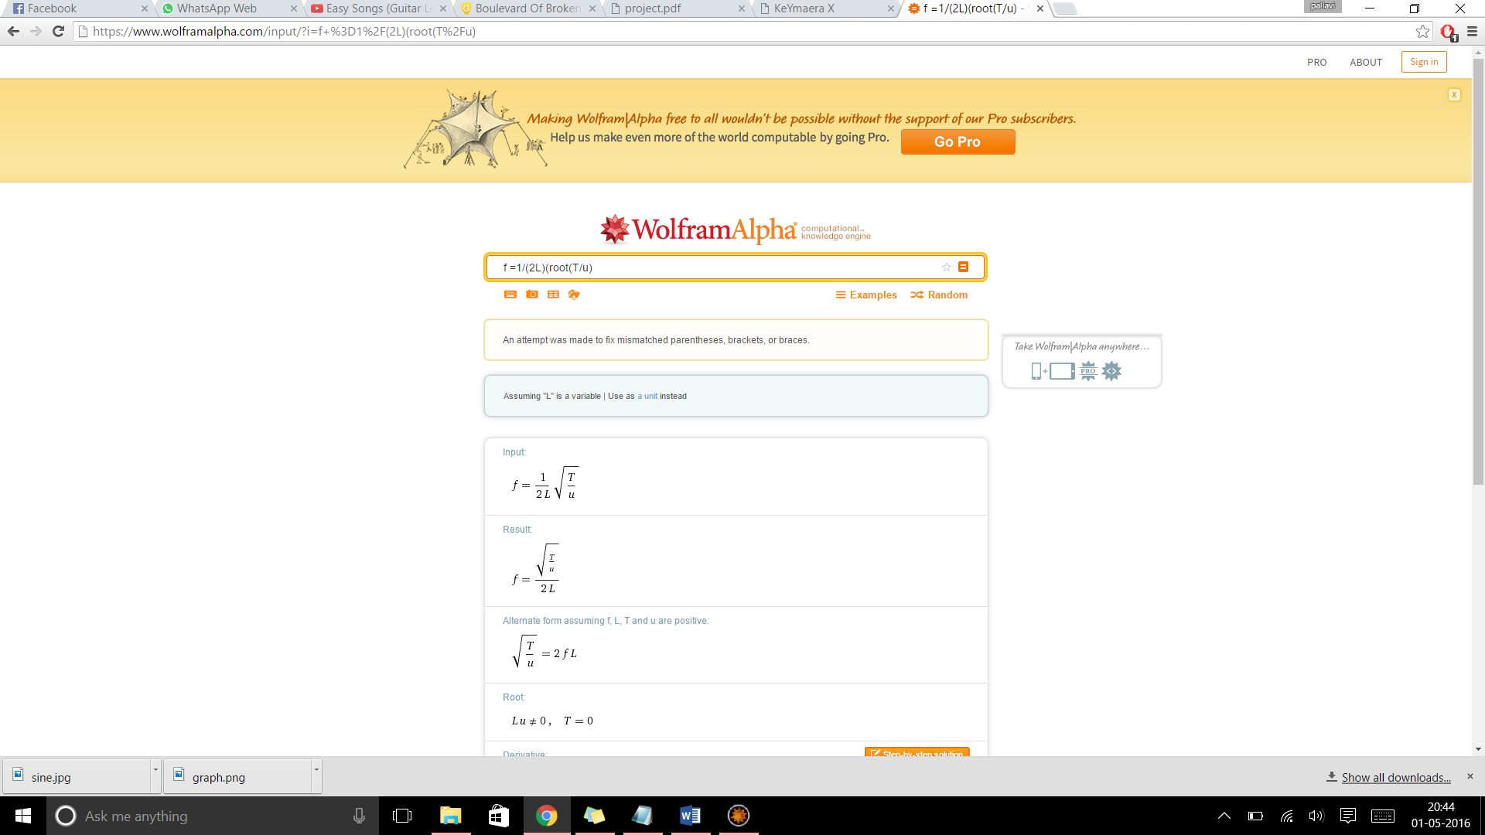
THEORY
f = fundamental frequency
L = length of string
T = tension in the string
u = mass per unit length

Slide 7
THEORY
L = pegR*alpha
pegX
alpha = sin⁻¹(pegY/pegR)
pegR
L
pegY
L’ = pegR/((pegR^2 - pegY^2)^(1/2))*(pegV*pegX)
alpha
pegR = radius of the peg
(pegX, pegY) = points on the circumference of the peg
alpha = angle subtended at the center
L = length of arc

Slide 8
MODEL
Event driven model: peg rotates until desired frequency is achieved
Assumption: String is always too slack
Efficiency condition: final frequency equals ideal frequency
  f = fideal
Safety Condition: string never snaps
  tension < tmax
Peg is modelled by:
  pegX' = -(pegV*pegY)/pegR
  pegY' = (pegV*pegX)/pegR

Slide 9
MODEL
Rate of change of length of string with respect to
rotation of peg:
  L' = (pegR*pegV*pegX)/(pegR² – pegY²)^^{1/2}
  L >= (1/2*fideal)*(tension/u)^{1/2}

Slide 10
CONCLUSION
KeYTuner proposes a model of a clip-on guitar tuner that
automates the process of tuning.
Presently models the tuning of one string but can easily be expanded to multiple strings.
Multiple string instruments even!

Slide 11
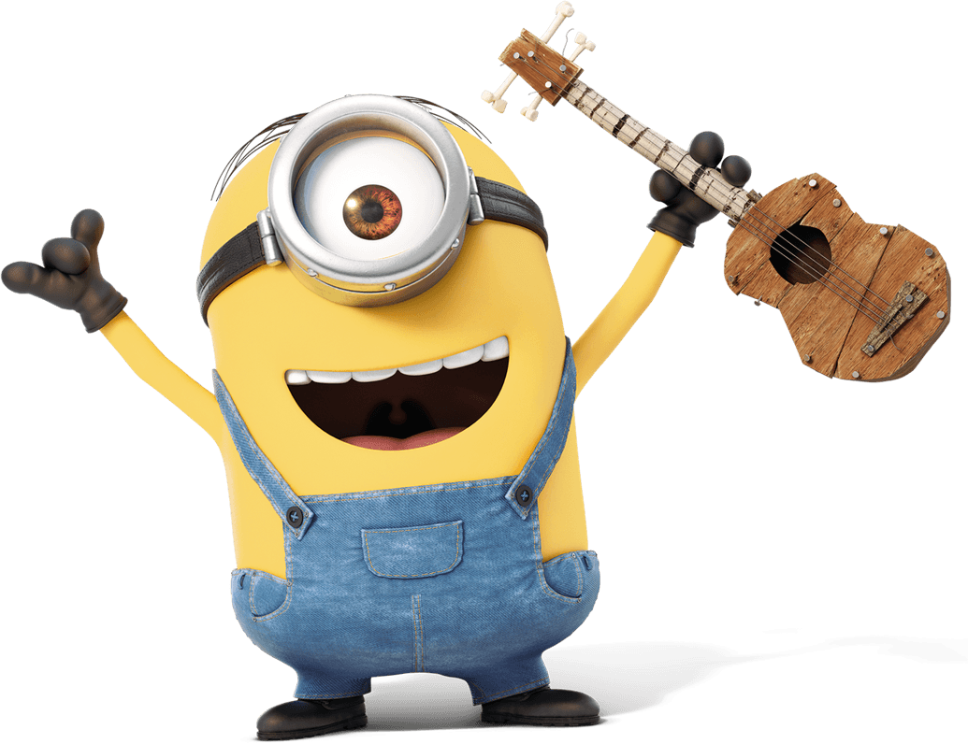
…Questions?
THANK YOU!

