Slide 1
Safe Path Planning for an Autonomous Agent in a Hostile Environment
Aka
SAVE PACMAN!
Cyber Physical Systems
Jimit Gandhi and Astha Prasad

Slide 2
OUTLINE
Inspiration
Related Work
Basic Model
Model Extensions
Safety
Methodology
Hybrid game extension
Future Work

Slide 3
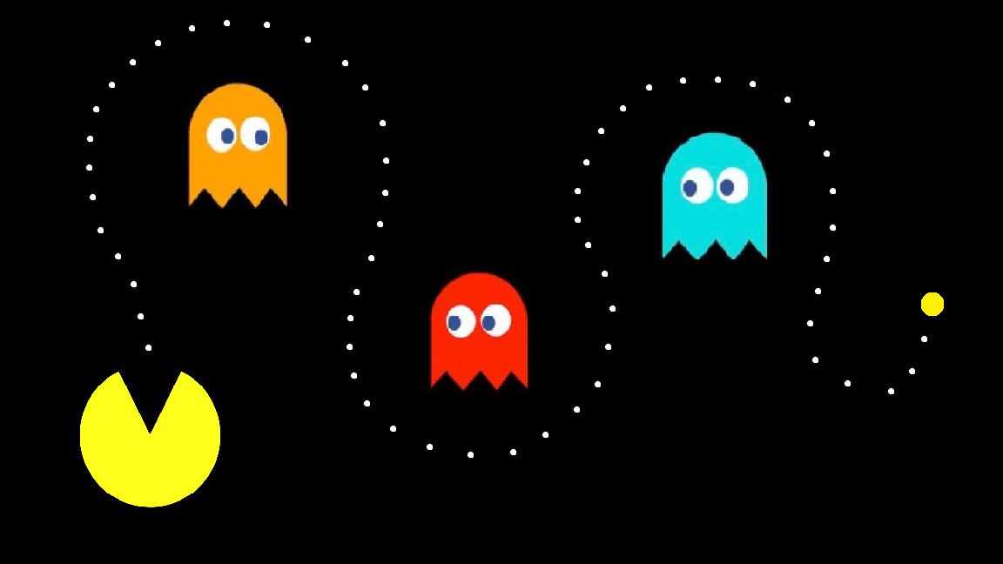
INSPIRATION
Cherished arcade game
Proven NP-Hard problem
Models safety critical dynamics
Maps to real world systems
Easily expandable to multiple scenarios

Slide 4
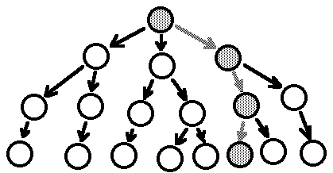
RELATED WORK
Plenty ongoing research on the PacMan framework
The tree explodes exponentially
SIMPLE TREE SEARCH ALGORITHM

Slide 5
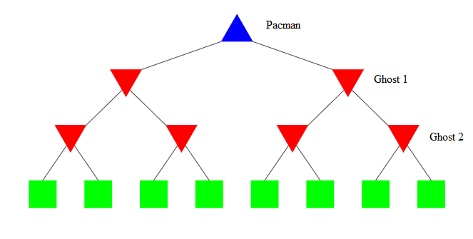
RELATED WORK
MINIMAX ALGORITHM

Slide 6


BASIC MODEL
Time triggered system containing:
PACMAN
Pacman moves in a 2D plane following circular dynamics
Capable of acceleration and braking for maximum time T
Single PacMan of finite radius
GHOST
Moves in a 3D plane following linear dynamics
Can be static, moving with constant velocity or accelerate/decelerate for at most time T
Single to multiple ghosts of finite radii

Slide 7
BASIC MODEL
INTERACTION AND CONTROL
PacMan knows the location of the ghosts at control decisions
Decisions to accelerate or decelerate are made accordingly
MAZE / WORLD MAP
Maze is emulated by including multiple static obstacles
Ghosts exist in increasing number and degree of dynamic capability

Slide 8
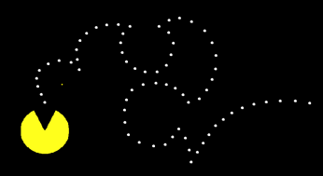
MODEL EXTENSIONS
We identified and proved models at 7 milestones:
Circular dynamics for PacMan with no obstacles

Slide 9
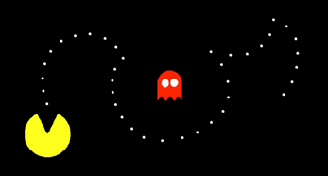
MODEL EXTENSIONS
2. Circular dynamics for PacMan with one static obstacle

Slide 10
MODEL EXTENSIONS
3. Circular dynamics for PacMan with multiple static obstacles

Slide 11
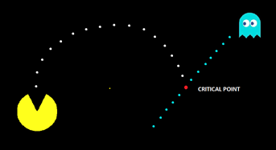
MODEL EXTENSIONS
4. Circular dynamics for PacMan with a single ghost moving with constant velocity

Slide 12
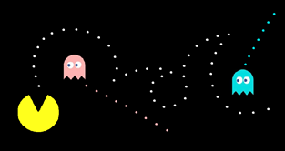
MODEL EXTENSIONS
5. Circular dynamics for PacMan with multiple ghosts moving with constant velocity

Slide 13
MODEL EXTENSIONS
6. Circular dynamics for PacMan with a single ghost than can accelerate and brake at random
7. Circular dynamics for PacMan with multiple ghosts than can accelerate and brake at random

Slide 14
SAFETY
In a time triggered model, we have updates of the ghosts once in at most time interval T
For every action of the ghost Pac Man decides which of his actions will be safe for the time triggered interval
Similar to MiniMax algorithm, looks for worst case scenario
In our case, as the PacMan only knows the velocity and the position of the ghost, it sees two steps ahead of its time, considers all actions of ghost and then decides
Safety Conditions - Pac Man does not collide with ghost and follows circular dynamics at all times

Slide 15
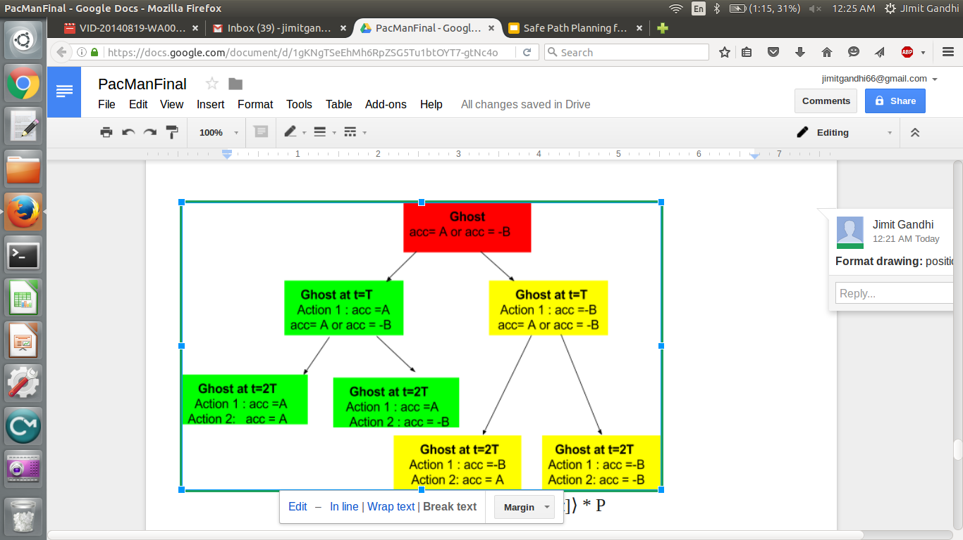
METHODOLOGY
The system of a ghost and Pac Man is a differential Game Logic.
The ghost randomly chooses to either accelerate and brake
Based on the ghost choice, Pac Man makes a safe decision
The tree is formed based on ghost’s action

Slide 16
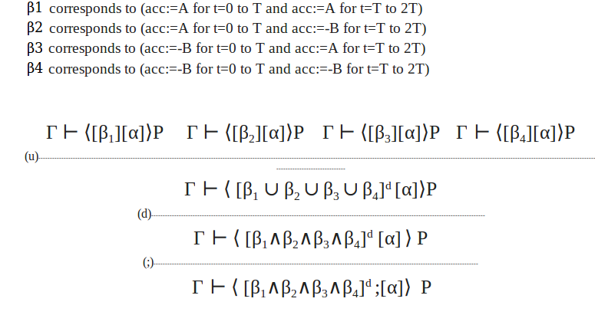
HYBRID GAME MODEL
The complex hybrid game is simplified to four hybrid programs and can be proved by Keymaera

Slide 17
CONCLUSION AND FUTURE WORK
Optimize and prove the control design for harder scenarios. (Actual pac man Maze with 5 ghosts)
This controller is based on the MiniMax algorithm.
Employ more intelligent control design for instance the one based on M-star algorithm and others.

