Slide 1
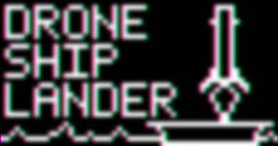
Drone Ship Lander
Foundations of Cyber-Physical Systems
David Kyle

Slide 2
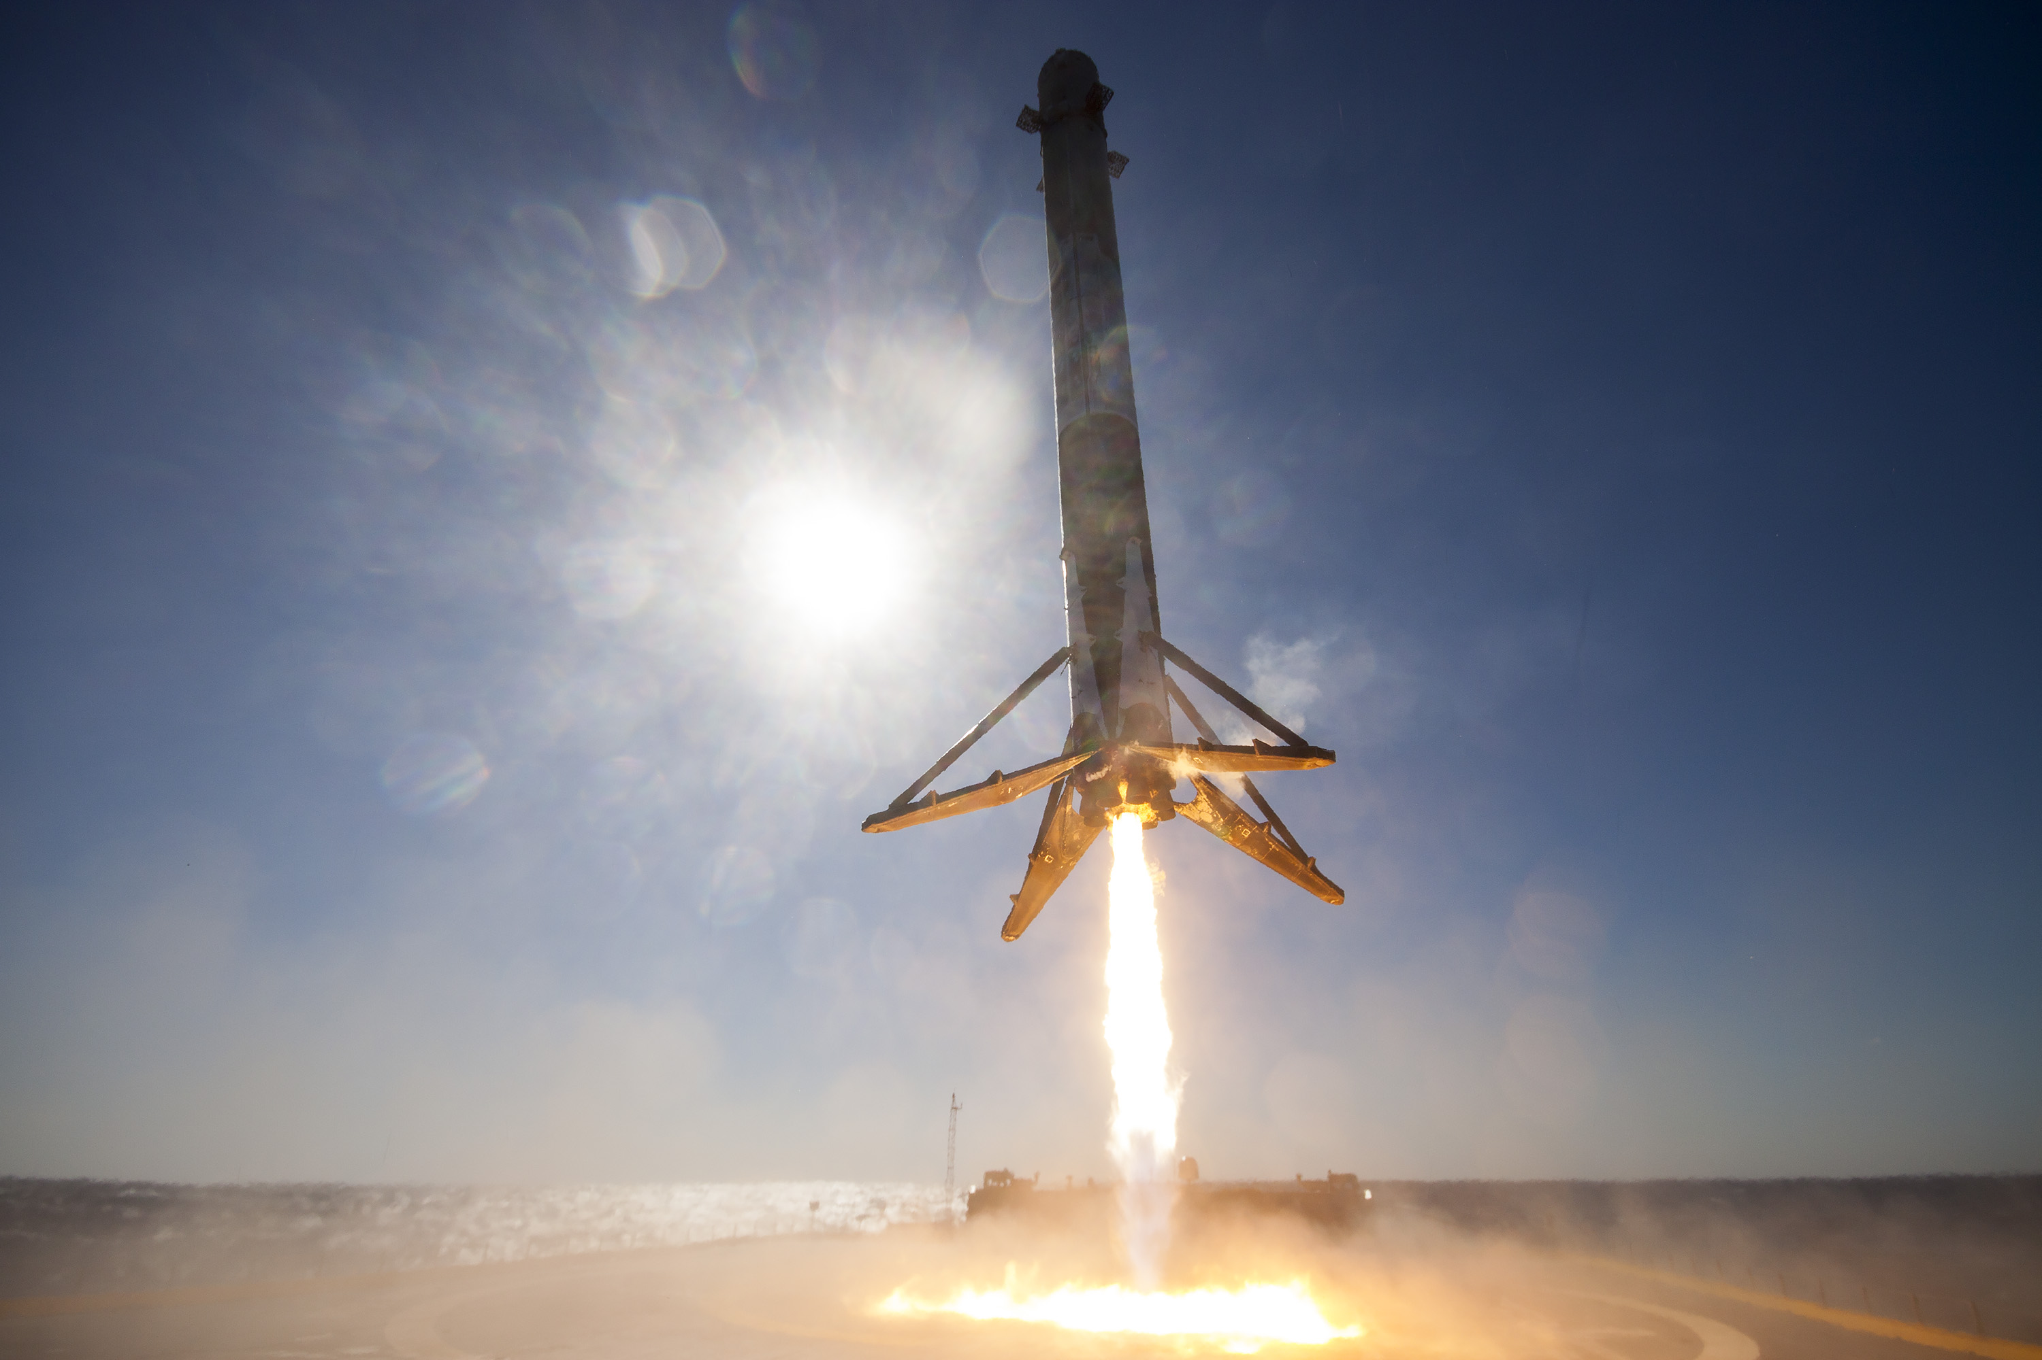
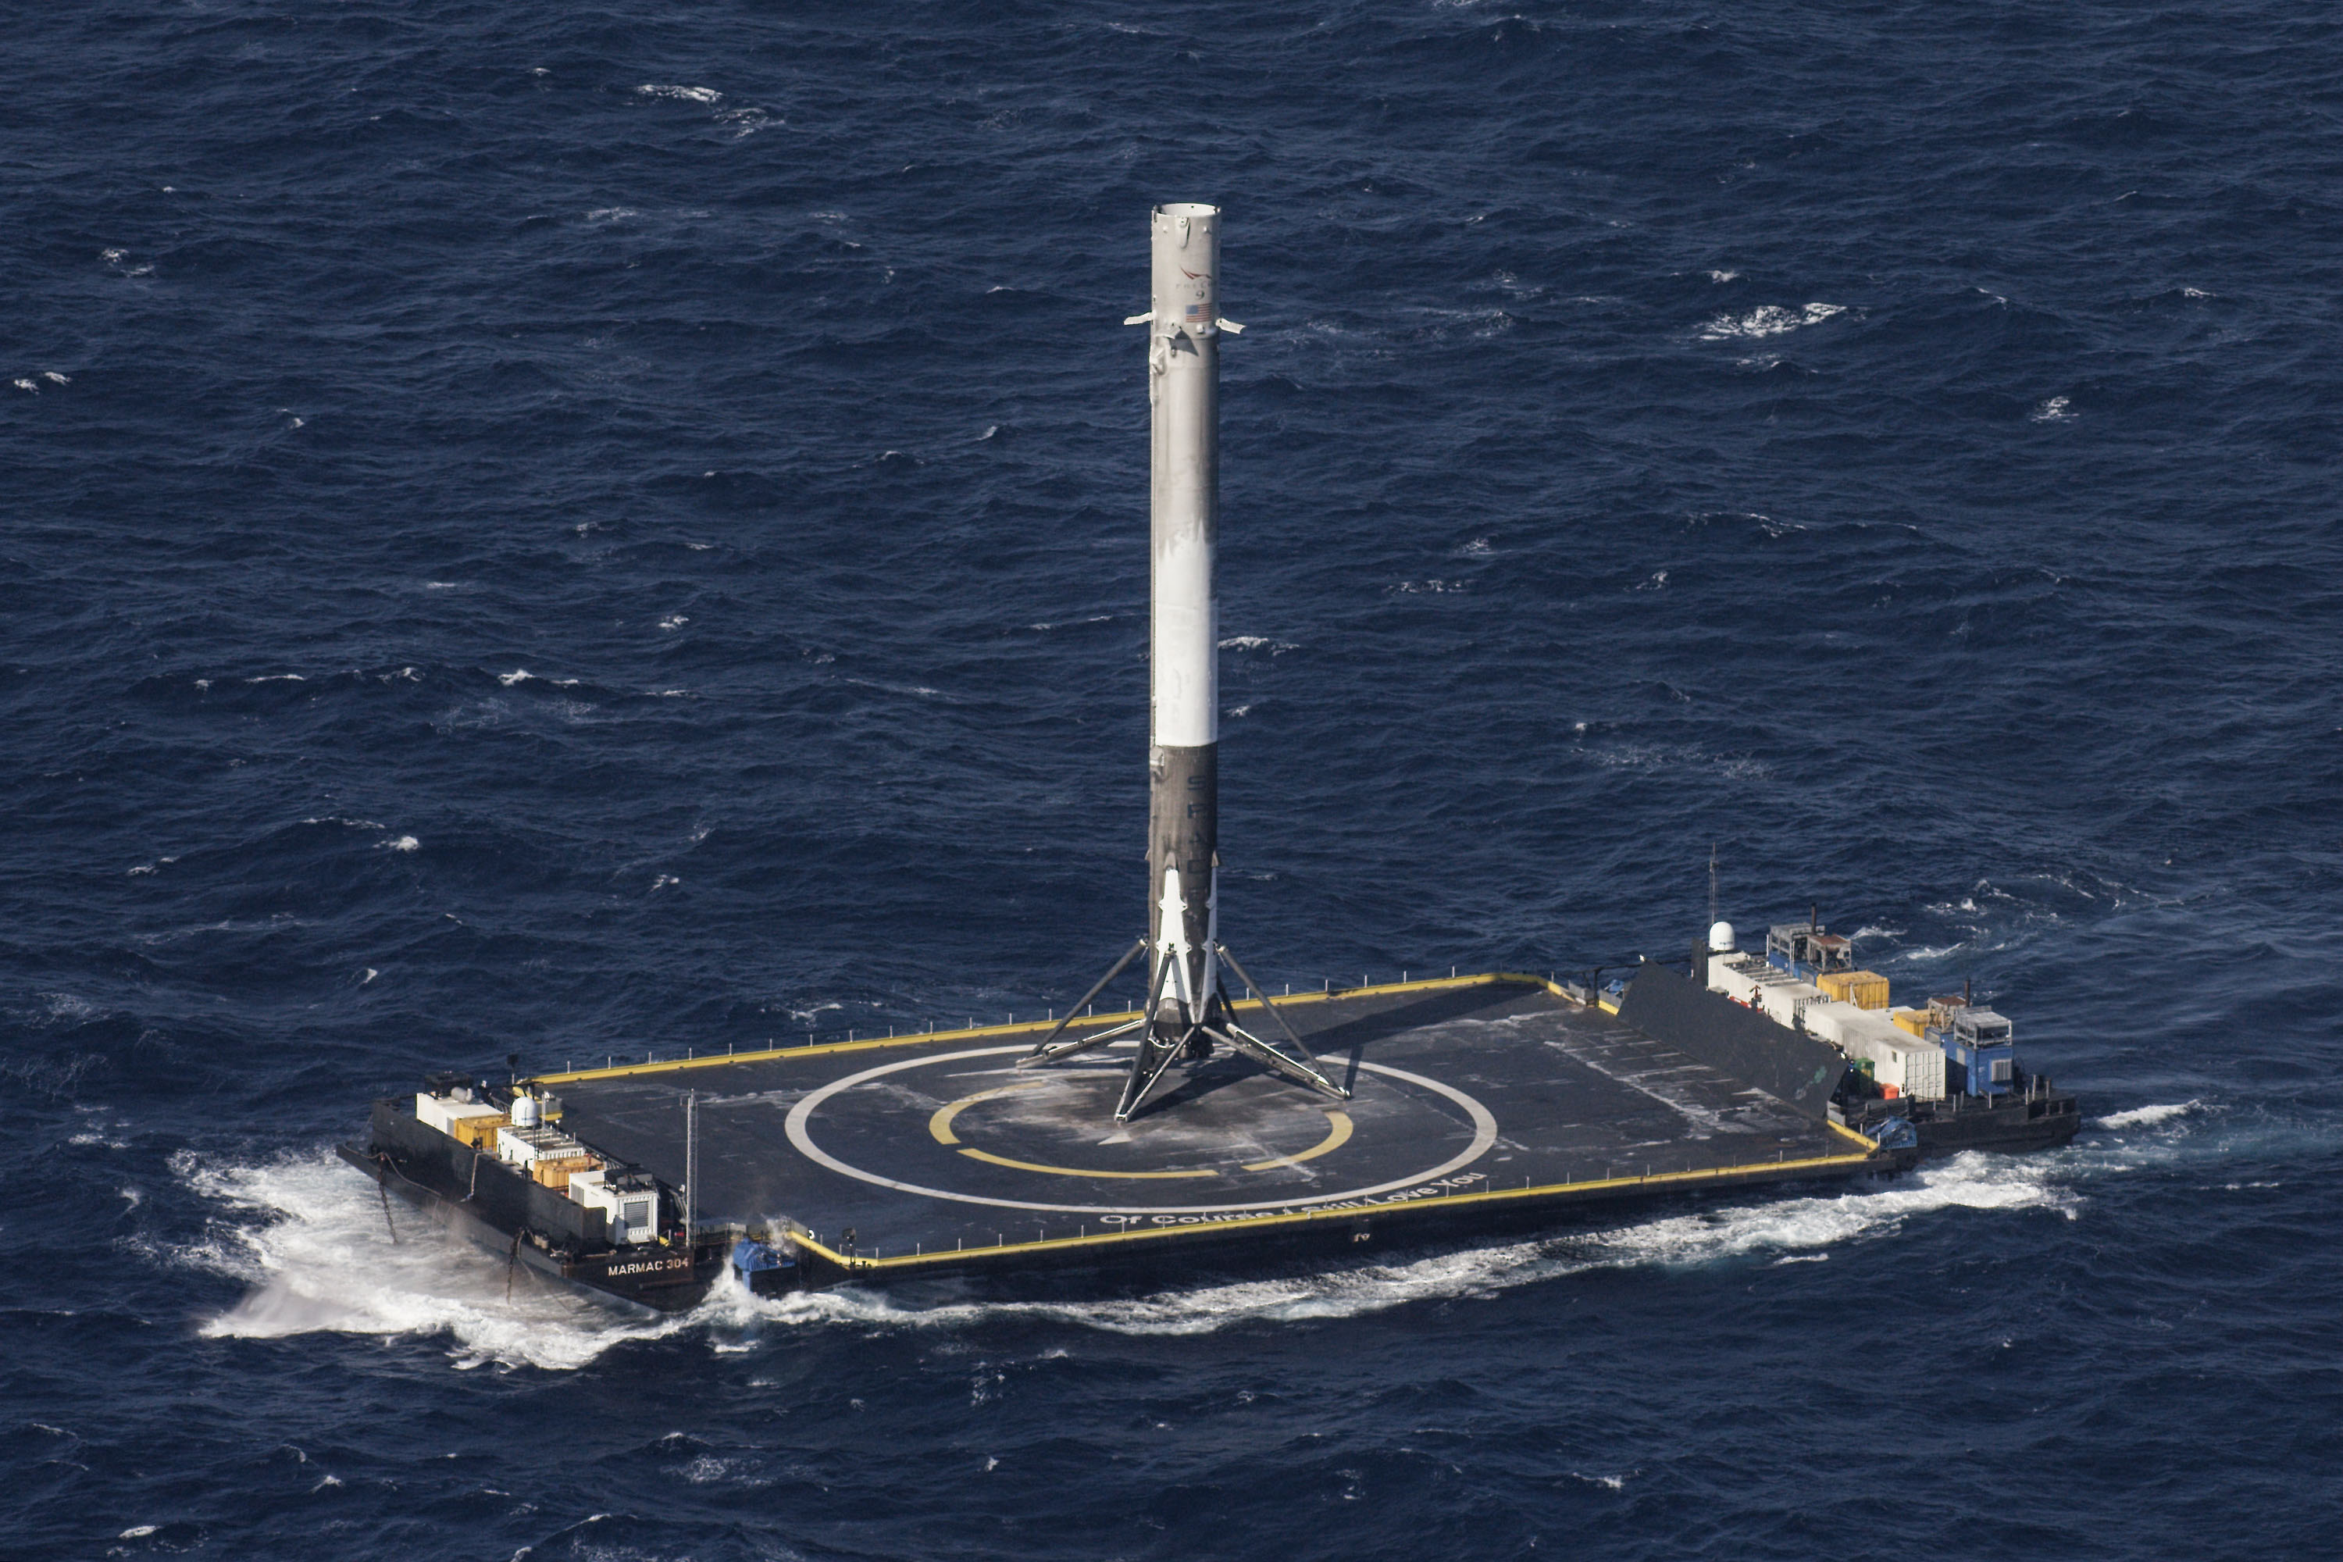
Scenario
Space Exploration Technologies (SpaceX) is pursuing a reusable launcher
  Current launchers all one-time-use, main reason launches are so expensive
  Shuttle was mostly reusable, but too complex; refurbishment cost too much
Their approach: propulsively land the Falcon 9 first stage booster, either:
  Back at launch site (large cost to payload mass)
    One attempt, one success
  On a drone ship (more difficult, but much less cost to payload mass)
    Drone ships are based on barges, but fitted with stabilization engines
    5 attempts, including one success, on the ship “Of Course I Still Love You”
This project seeks to model these scenarios, and verify control logic safely landing the booster.

Slide 3
Previous Work (fall 2014)
The Returning Rocket:
Friend or Foe?
Asteroid Approach
David Franklin and Philip Massey
Same motivating scenario (SpaceX)
Focus: inverse pendulum problem of keeping booster upright
  We will consider this solved; will assume rocket can do this.
Analysis of landing itself limited (no accounting for fuel consumption)
  We will followup on this part
Kerry Snyder
Different scenario; probe approaching an asteroid
Essentially same as dynamics as landing, though
Accounts for fuel consumption
  We will start from this model, and try to take it further

Slide 4
Initial Goals
Starting from the model in Asteroid Approach, will attempt to:
  Port model to Keymaera X, and produce a tactic
  Enforce stopping at surface
    Model permits stopping in space near asteroid
    We must stop at the deck of the drone ship
  Enforce fuel budget
    Proven model in paper assumes sufficient fuel
    Fuel tracked to adjust effective acceleration
  Model basic ocean dynamics
    Sinusoidal swells of the ocean
    Drone ships dampen some movement, but not all

Slide 5
Starting Model (from Asteroid Approach)
(ge = 9.81 /* earth's gravity, part of ISP */ & mi = dm + M /* initial mass */
& m = mi /* initialize mass */ & f > 0 /* force of thuster */
& isp > 0 /* engine ISP */ & M > 0 /* fuel mass */ & dm > 0 /* dry mass */
& T > 0 /* time constant is necessary, positive */
& v >= 0 /* we must be either nonmoving or accelerating */
& f >= 2*m*g /* f >= 2*ma, derived through the proof */
& g > 0 /* gravity acceleration is necessary, positive */
& p >= -v^2/(2*(g-(f/mi))) /* we must be able to brake and safely stop */
& p >= 0) /* we must be on the positive side */
-> [
(if (p - v*T - (1/2)*g*T^2 > -(v+g*T)^2/(2*(g-(f/mi)))) then a := 0 else a := 1 fi;
t := 0; {p' = v, v' = g - a*(f/m), t' = 1, m' = -a*(f/(isp*ge))
& p >= 0 & v >= 0 & t <= T & m >= dm}
@invariant(m <= mi, p >= -v^2/(2*(g-(f/m))))
)*@invariant(p >= -v^2/(2*(g-(f/m))) & p >= 0 & m <= mi & m >= dm & v >= 0);
] (p >= -v^2/(2*(g-(f/m))) & p >= 0)

Slide 6
Starting Model (from Asteroid Approach)
Problem!
My version doesn’t prove
In Keymaera X
(ge = 9.81 /* earth's gravity, part of ISP */ & mi = dm + M /* initial mass */
& m = mi /* initialize mass */ & f > 0 /* force of thuster */
& isp > 0 /* engine ISP */ & M > 0 /* fuel mass */ & dm > 0 /* dry mass */
& T > 0 /* time constant is necessary, positive */
& v >= 0 /* we must be either nonmoving or accelerating */
& f >= 2*m*g /* f >= 2*ma, derived through the proof */
& g > 0 /* gravity acceleration is necessary, positive */
& p >= -v^2/(2*(g-(f/mi))) /* we must be able to brake and safely stop */
& p >= 0) /* we must be on the positive side */
-> [
(if (p - v*T - (1/2)*g*T^2 > -(v+g*T)^2/(2*(g-(f/mi)))) then a := 0 else a := 1 fi;
t := 0; {p' = v, v' = g - a*(f/m), t' = 1, m' = -a*(f/(isp*ge))
& p >= 0 & v >= 0 & t <= T & m >= dm}
@invariant(m <= mi, p >= -v^2/(2*(g-(f/m))))
)*@invariant(p >= -v^2/(2*(g-(f/m))) & p >= 0 & m <= mi & m >= dm & v >= 0);
] (p >= -v^2/(2*(g-(f/m))) & p >= 0)

Slide 7
Starting Model (from Asteroid Approach)
Problem!
My version doesn’t prove
In Keymaera X, with adapted approach
(ge = 9.81 /* earth's gravity, part of ISP */ & mi = dm + M /* initial mass */
& m = mi /* initialize mass */ & f > 0 /* force of thuster */
& isp > 0 /* engine ISP */ & M > 0 /* fuel mass */ & dm > 0 /* dry mass */
& T > 0 /* time constant is necessary, positive */
& v >= 0 /* we must be either nonmoving or accelerating */
& f >= 2*m*g /* f >= 2*ma, derived through the proof */
& g > 0 /* gravity acceleration is necessary, positive */
& p >= -v^2/(2*(g-(f/mi))) /* we must be able to brake and safely stop */
& p >= 0) /* we must be on the positive side */
-> [
(if (p - v*T - (1/2)*g*T^2 > -(v+g*T)^2/(2*(g-(f/mi)))) then a := 0 else a := 1 fi;
t := 0; {p' = v, v' = g - a*(f/m), t' = 1, m' = -a*(f/(isp*ge))
& p >= 0 & v >= 0 & t <= T & m >= dm}
@invariant(m <= mi, p >= -v^2/(2*(g-(f/m))))
)*@invariant(p >= -v^2/(2*(g-(f/m))) & p >= 0 & m <= mi & m >= dm & v >= 0);
] (p >= -v^2/(2*(g-(f/m))) & p >= 0)
Problem!
Literal conversion doesn’t prove either

Slide 8
Starting Model (from Asteroid Approach)
Problem!
My version doesn’t prove
In Keymaera X, with adapted approach
(ge = 9.81 /* earth's gravity, part of ISP */ & mi = dm + M /* initial mass */
& m = mi /* initialize mass */ & f > 0 /* force of thuster */
& isp > 0 /* engine ISP */ & M > 0 /* fuel mass */ & dm > 0 /* dry mass */
& T > 0 /* time constant is necessary, positive */
& v >= 0 /* we must be either nonmoving or accelerating */
& f >= 2*m*g /* f >= 2*ma, derived through the proof */
& g > 0 /* gravity acceleration is necessary, positive */
& p >= -v^2/(2*(g-(f/mi))) /* we must be able to brake and safely stop */
& p >= 0) /* we must be on the positive side */
-> [
(if (p - v*T - (1/2)*g*T^2 > -(v+g*T)^2/(2*(g-(f/mi)))) then a := 0 else a := 1 fi;
t := 0; {p' = v, v' = g - a*(f/m), t' = 1, m' = -a*(f/(isp*ge))
& p >= 0 & v >= 0 & t <= T & m >= dm}
@invariant(m <= mi, p >= -v^2/(2*(g-(f/m))))
)*@invariant(p >= -v^2/(2*(g-(f/m))) & p >= 0 & m <= mi & m >= dm & v >= 0);
] (p >= -v^2/(2*(g-(f/m))) & p >= 0)
Problem!
Literal conversion doesn’t prove either
Big Problem!
Model has serious typo; original proof is meaningless

Slide 9
New Goal
Correct asteroid approach model
  Decided to go event based, hopefully simpler to prove
  More abstract, but would expect to still be applicable
Try to prove the corrected asteroid approach model
By the time I figured out these problems, no time left to go further

Slide 10
Model
(ge = 9.81 /* earth's gravity, part of ISP */ & mi = dm + M /* initial mass */
& m = mi /* initialize mass */ & f > 0 /* force of thuster */ & isp > 0 /* engine ISP */
& M > 0 /* fuel mass */ & dm > 0 /* dry mass */
& v >= 0 /* we must be either nonmoving or accelerating */
& f >= 2*m*g /* f >= 2*ma, derived through the proof */
& g > 0 /* gravity acceleration is necessary, positive */
& p >= -v^2/(2*(g-(f/mi))) /* we must be able to brake and safely stop */
& p >= 0) /* we must be on the positive side */
-> [
{{ {?(p > -v^2/(2*(g-(f/mi))));
{p' = -v, v' = g, m' = 0 & p >= 0 & v >= 0 & m >= dm & p >= -v^2/(2*(g-(f/mi)))}
} ++
{ ?(p <= -v^2/(2*(g-(f/mi))));
a0 :=*; ?a0 * mi = g * mi - f;
mr :=*; ?mr * isp * ge = f;
v0 := v; p0 := p; /* differential ghosts */
{p' = -v, v' = g - (f/m), m' = -mr, p0' = -v0, v0' = a0 & p >= 0 & v >= 0 & m >= dm}
} } }*@invariant(p >= -v^2/(2*(g-(f/mi))) & f >= 2*mi*g & p >= 0 &
m <= mi & m >= dm & v >= 0)
] (p >= -v^2/(2*(g-(f/m))) & p >= 0)

Slide 11
Proof Overview
Use the p0, v0, and a0 differential ghosts to construct a lower bound for real p
a0 is constant during ODE, so ODE with p0, v0, and a0 is solvable
After cutting in constraints for p, v, and a, left with ODE that should be solvable:
[ {p'=-v, v'=g-f/m, m'=-mr, p0'=-v0, v0'=a0
& p≥0 ∧ v≥0 ∧ m≥dm ∧ m≤mi ∧ v≤v0 ∧ p≥p0 }
] p0≥-v²/(2·a0)
Keymaera X doesn’t appear to permit hiding portions of ODE that have no effect on property (p’, v’, and m’)
Created new model with final ODE (minus irrelevant parts), then proved that ODE separately

Slide 12
Conclusion
Unfortunately, was unable to meet initial goals
But peer review and repetition of results is still useful
Original goals would still be interesting for future research

Slide 13
Questions?

